Slide 1
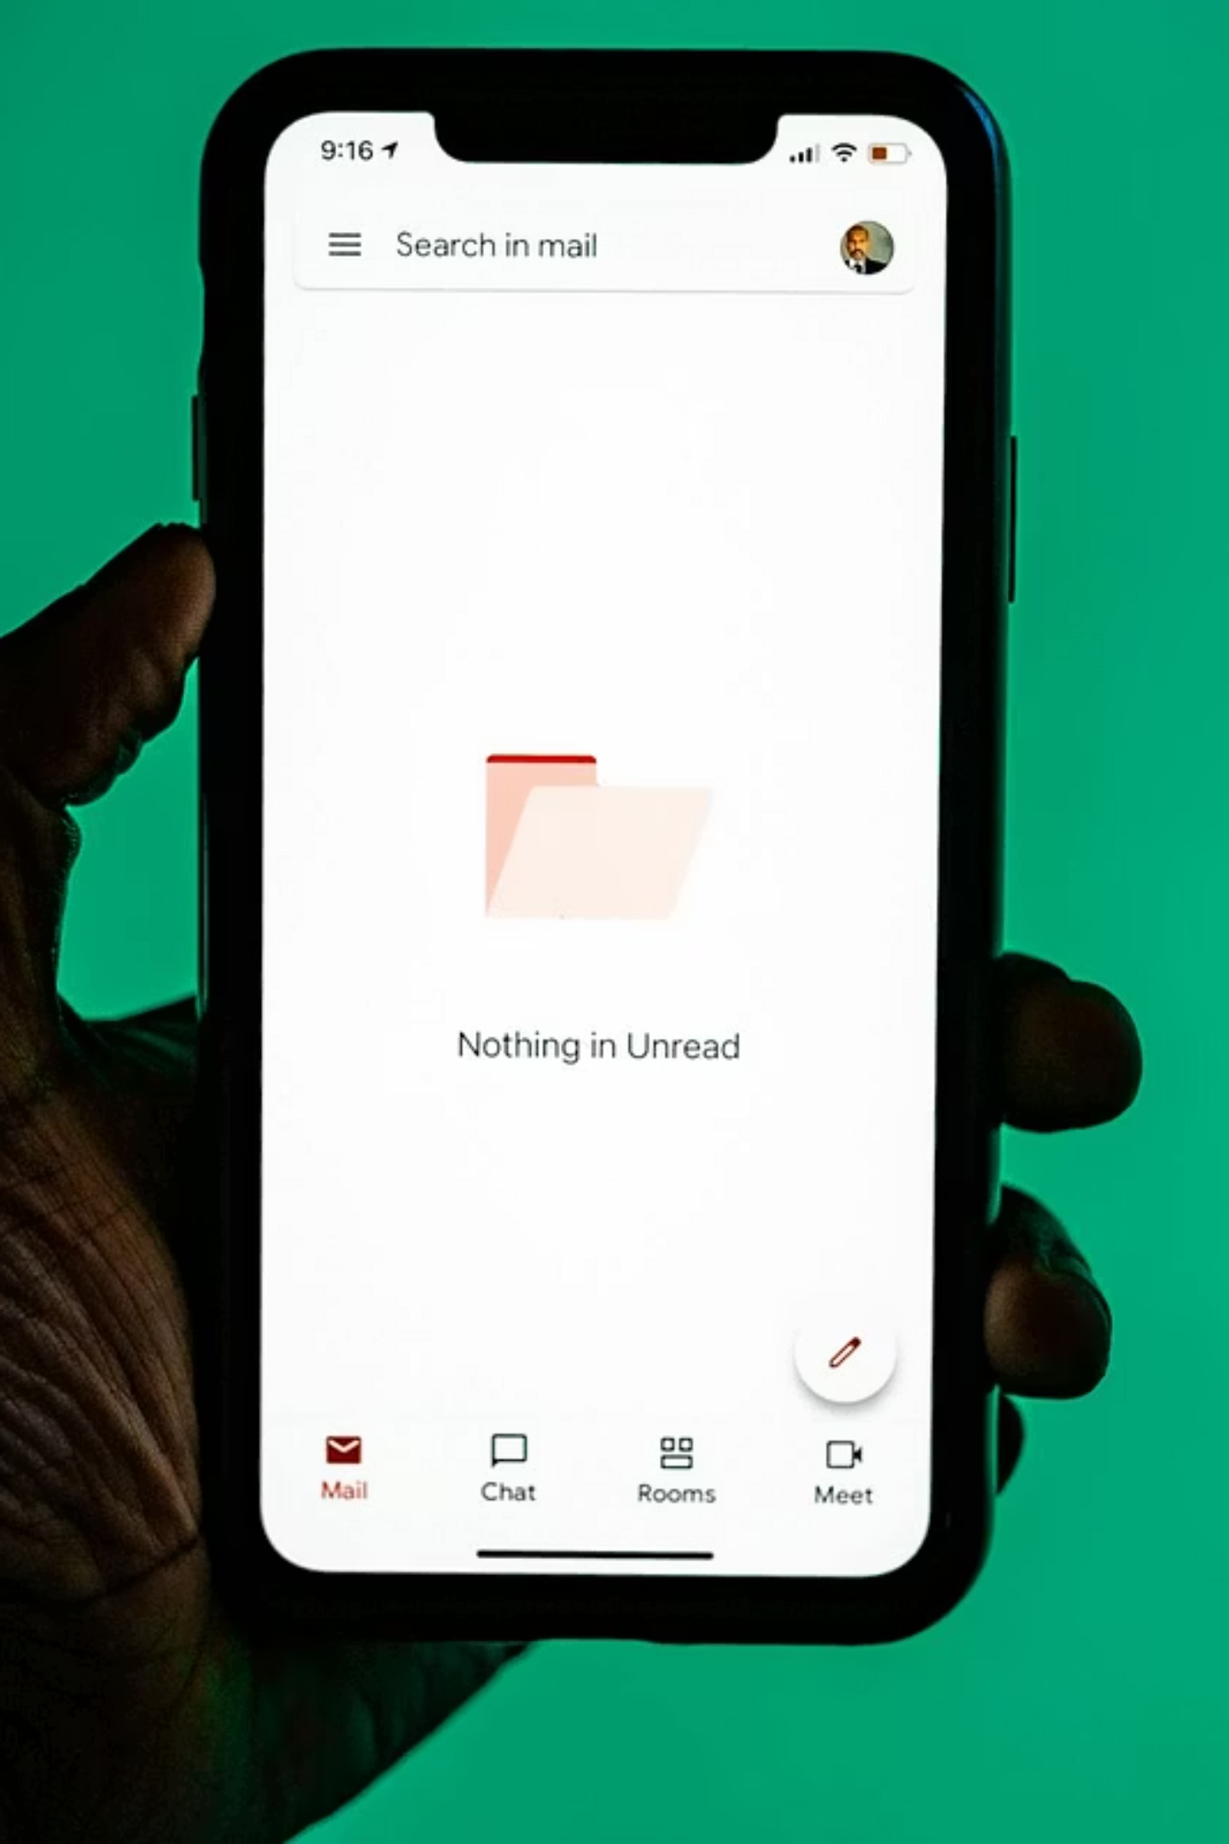
IMAP Protocol
Internet Message Access Protocol
A comprehensive guide to modern email retrieval and synchronization

Slide 2
What is IMAP?
Internet Message Access Protocol (IMAP) is an email retrieval protocol that enables users to access and manage their email messages directly on a mail server, rather than downloading them to a local device. This fundamental difference sets IMAP apart from older email protocols and makes it the standard for modern email systems.
Key Applications
Gmail and Google Workspace
Microsoft Outlook/Exchange
Yahoo Mail
Apple iCloud Mail
Corporate email systems
IMAP is the backbone of contemporary email services including Gmail, Outlook, Yahoo Mail and corporate email systems. It's particularly essential in environments where users need to access their email from multiple devices—laptops, smartphones, tablets and desktop computers—while maintaining a consistent, synchronized view of their inbox.

Slide 3




Purpose and Evolution
IMAP was specifically designed to overcome the significant limitations of older email retrieval methods, particularly POP3 (Post Office Protocol version 3). The protocol addresses the growing need for flexible, multi-device email access in our mobile-first world.
Centralized Storage
Multi-Device Access
Keeps all email messages stored on the server, eliminating the need to download and store messages locally on each device.
Provides seamless access from smartphones, tablets, laptops and desktops while maintaining a unified view of your inbox.
Real-Time Sync
Efficient Management
Any changes made on one device—deleting, moving or marking messages—are instantly reflected across all connected devices.
Supports advanced email organization with folders, labels, flags and selective message downloading for optimal performance.

Slide 4

IMAP in Network Architecture
01
02
Application Layer Protocol
TCP Transport
IMAP operates at the Application Layer (Layer 7) of the OSI model, providing the interface between email clients and servers.
Uses TCP (Transmission Control Protocol) for reliable, connection-oriented data transmission, ensuring message integrity.
03
04
Client-Server Model
Server-Centric Storage
Follows a clear client-server architecture where email clients connect to IMAP servers to retrieve and manage messages.
Unlike POP3, IMAP keeps email data stored on the server indefinitely, allowing access from multiple locations and devices.

Slide 5

How IMAP Works
The IMAP protocol follows a structured process to establish connections, authenticate users, and synchronize email data across devices.
Connection Establishment
The email client initiates a TCP connection to the IMAP server using port 143 (unencrypted) or port 993 (encrypted with SSL/TLS).
User Authentication
The client sends authentication credentials (username and password, or OAuth tokens) to verify user identity and establish secure access.
Message Retrieval
The client can fetch email headers first (for quick inbox loading) or download full messages, attachments, and metadata as needed.
Server Storage
Unlike POP3, all emails remain stored on the server, allowing access from other devices and preserving messages even if a device is lost.
Synchronization
Any actions performed—reading, deleting, moving or flagging messages—are synchronized across all connected devices in real-time.

Slide 6
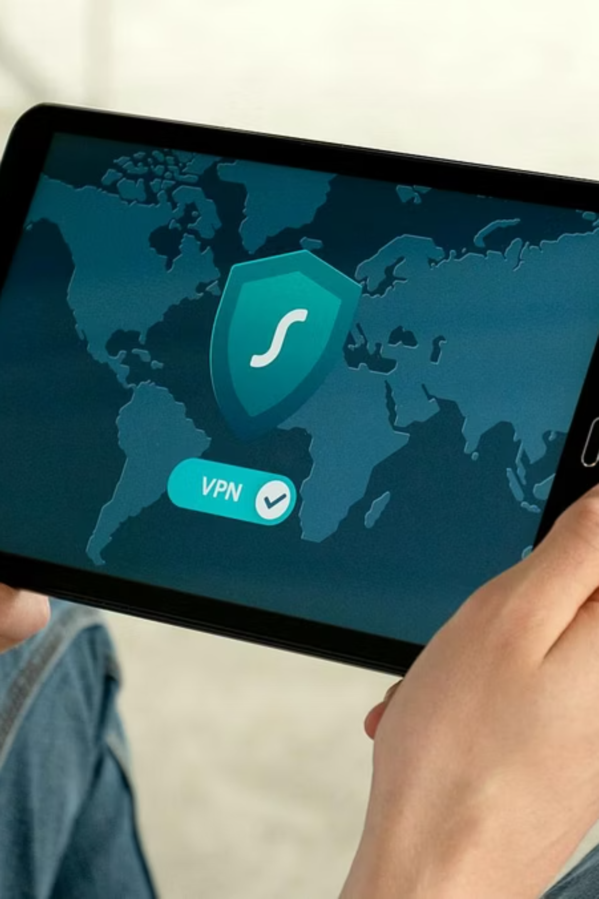

Ports and Security
Standard IMAP (Port 143)
IMAPS (Port 993)
Port: 143
Port: 993
Protocol: TCP
Protocol: TCP with SSL/TLS
Encryption: None (unencrypted)
Encryption: Full SSL/TLS encryption
Use Case: Internal networks or when SSL/TLS is not available
Use Case: Modern systems, public networks, secure email access
Security Warning: Credentials and email content are transmitted in plain text, making this port vulnerable to eavesdropping on public networks.
Best Practice: Most modern email systems default to IMAPS on port 993 to ensure encrypted communication and protect sensitive data.

Slide 7






Key Features of IMAP
Server-Based Storage
Multi-Device Access
Messages remain on the server indefinitely, freeing local device storage and enabling access from any internet-connected device. Users can choose to download messages locally for offline access while maintaining server copies.
Access your email from smartphones, tablets, laptops and desktop computers simultaneously. Changes made on one device instantly appear on all others, maintaining consistency across your digital ecosystem.
Folder and Label Support
Selective Message Download
Create and manage folders, subfolders and labels directly on the server. Organize messages into categories, apply color-coding and maintain consistent folder structures across all devices.
Choose to download only message headers initially for faster inbox loading, then download full messages and attachments on demand. This optimizes bandwidth usage and improves performance on slow connections.
Real-Time Synchronization
Offline Access Through Caching
Any modifications—reading messages, deleting, moving to folders or marking as important—are immediately synchronized with the server and propagated to all connected devices, ensuring everyone sees the same state.
Email clients can cache messages locally, allowing users to read, compose and organize emails without an internet connection. Changes sync automatically when connectivity is restored.

Slide 8
IMAP vs POP3
Understanding the fundamental differences between IMAP and POP3 helps determine which protocol best suits your email needs.
Feature
IMAP
POP3
Email Storage
Server-based
Local device
Multi-Device Access
Supported
Not supported
Synchronization
Yes
No
Email Organization
Advanced (folders, labels)
Limited
Internet Required
For full functionality
Only for download
Storage Space
Server storage limits
Device storage limits
Data Loss Risk
Lower (server backup)
Higher (device failure)
Bandwidth Usage
Higher (constant sync)
Lower (download once)

Slide 9
Data Protection
Advantages and Limitations
✓ Advantages
⚠ Limitations
Universal Access
Internet Dependency
Emails accessible from anywhere with internet connectivity, on any device with proper credentials.
Requires continuous internet connection for full functionality, though offline caching provides limited relief.
Consistent View
Storage Quotas
Maintains identical inbox state across all devices, preventing confusion about message status.
Server storage limitations imposed by email providers may require regular mailbox cleanup to avoid exceeding quotas.
Data Protection
Server Resource Usage
Reduced risk of permanent data loss since messages remain on servers with backup systems.
Higher server resource consumption compared to POP3 due to constant synchronization and storage requirements.
Mobile-Ready
Initial Setup Complexity
Ideal for mobile and cloud-based email systems, supporting modern work-from-anywhere requirements.
Configuration can be more complex than POP3, requiring correct server settings and authentication methods.
Storage Management
Bandwidth Consumption
Users can manage server storage by periodically archiving or deleting old messages to stay within limits.
Continuous synchronization uses more bandwidth than POP3's download-once approach, potentially affecting mobile data plans.

Slide 10
Conclusion
IMAP remains a reliable and widely adopted email retrieval protocol that effectively supports modern, multi-device communication needs. Its server-based architecture provides significant advantages over older protocols like POP3, particularly in environments where users access email from multiple devices and require consistent synchronization.
Industry Standard
Future-Proof
Versatile Solution
IMAP has become the de facto standard for modern email systems, powering services used by billions of people worldwide.
As mobile and cloud-based email usage continues growing, IMAP's advantages become increasingly valuable.
Suitable for both personal and professional email systems, from individual Gmail accounts to enterprise email platforms.
Thank You
Any Questions? Feedback?

